Slide 1
Genome Polymorphism Detection Using
De Bruijn
Graph
Group 11

Slide 2
Group Members
Dhruvjyoti Swain AM.EN.U4AIE20023
Dhanush Krishna R AM.EN.U4AIE2021
Pavithra P M Nair AM.EN.U4AIE20055
Pranav Jayasankar Nair AM.EN.U4AIE20056

Slide 3
Project Summary
Objectives: To identify polymorphisms that exist within a genome as well as see graph structures that form in the de Bruijn graph for particular types of polymorphisms (translocations, etc.)
Scope: Given ideal data (all kmers in the reference sequence are unique, and reads with no errors) the project helps detect basic genome polymorphism.

Slide 4
Literature Review
Polymorphism involves one of two or more variants of a particular DNA sequence. The most common type of polymorphism involves variation at a single base pair. Polymorphisms can also be much larger in size and involve long stretches of DNA.
Detecting polymorphisms in the genome is an important task for an individual specimen and for a species as whole. Whether it be identifying single nucleotide polymorphisms (SNPs) in an individual compared to a reference genome or comparing different species, identifying polymorphic differences is a difficult task.
For utilizing unmapped reads and to compare whole genomes is to construct a relaxed de Bruijn graph that allows for more complex genomic variation to be observable.

Slide 5
Background of the Study
In genomics, a genome-wide association study (GWA study, or GWAS)is an observational study of a genome-wide set of genetic variants in different individuals to see if any variant is associated with a trait.
GWA studies typically focus on associations between single-nucleotide polymorphisms (SNPs) and traits like major human diseases but can equally be applied to any other genetic variants and any other organisms.
Phylogenetic tree reconstruction is often completed through comparing homologous gene sequences in a group of species of interest.
Identification of homologous genes is a difficult task and is often a conservative process, allowing for only gene sequences that are very similar to be clustered together
This approach is limited because it only allows for comparing gene sequences instead of comparing whole genomes

Slide 6
Background of the Study
Creating a relaxed de bruijn graph on the initial sequence by relaxing some constraints of Standard De Bruijn Graph.
Conceptually, this method can be thought of as merging two separate deBruijn graphs by exploiting uniquely occurring kmers in one sequence as anchor points to merge the graphs.
Then we have taken an another sequence and appended the new k-1 mer to the de Bruijn graph.
Then we have observed the graph construction in both the cases.

Slide 7
Research Design: Methods
Standard de Bruijn Graph
A standard de Bruijn graph is a graph structure that represents the genome of an organism. de Bruijn graphs are commonly used for genome assembly and usually representative of a single species.
Beyond genome assembly, they have also been found to increase the percent mapped reads when mapping reads to a de Bruijn graph versus contigs.
In a de Bruijn graph, each node represents a unique kmer. Edges in the graph represent kmer overlaps. The graph is usually constructed from NGS reads where reads are broken into kmers and used to populate the graph.

Slide 8
Research Design: Methods
Relaxed de Bruijn Graph
A relaxed de Bruijn Graph is a modification of the standard de Bruijn Graph
It differs from the standard de Bruijn Graph in the following ways:
The graph contains sequence information for multiple species
Kmers can occur multiple times in the graph
By relaxing the constraints on the de Bruijn graph, we are able to identify interesting genomic variation in a tractable amount of time and space.

Slide 9
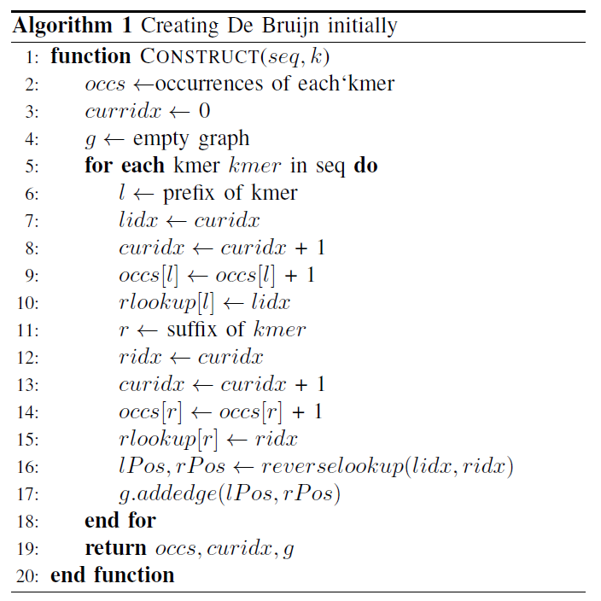
Research Design: Algorithms

Slide 10
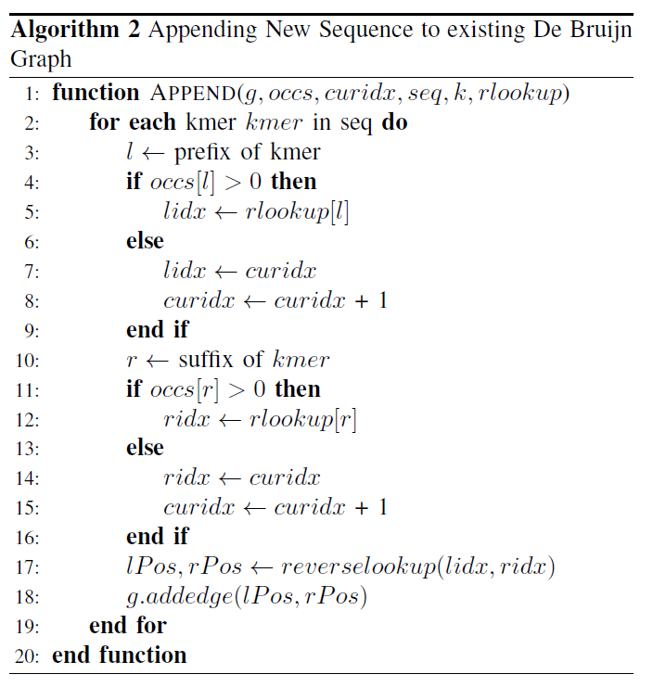
Research Design: Algorithms(contd.)

Slide 11
Data
We have taken multiple randomly generated genome sequences. We have first created the initial Relaxed De Bruijn graph. Then we have taken the sequence and appended the new k-1 mers onto the original De Bruijn graph.

Slide 12
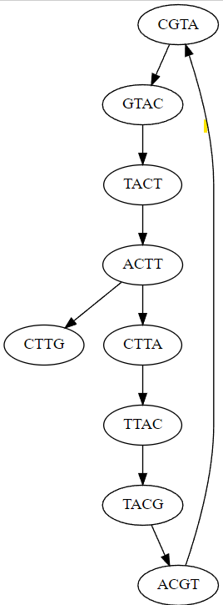
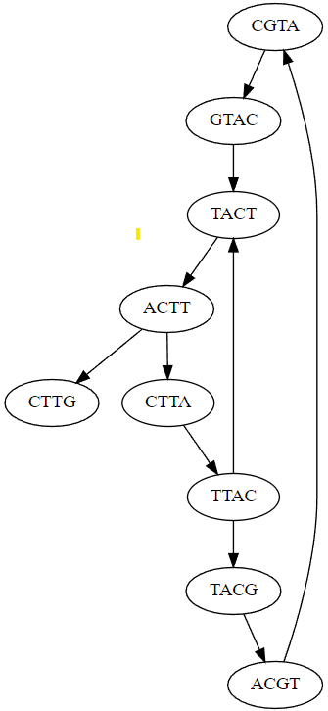
Results
Initial De Bruijn Graph from first read
Relaxed De Bruijn Graph formed after appending k-1mers from second read.

Slide 13
Discussion
On synthetic reads we could theoretically be able to detect the following polymorphisms:
Mutation
Insertion
Inversion
Translocation
One of the main drawbacks of this code is that is assumes ideal conditions (all kmers in the reference sequence are unique, and reads with no errors)

Slide 14
Conclusion
In this project, we have presented an method for constructing a relaxed de Bruijn graph and explained genome polymorphism and phylogenetic Tree reconstruction. We can use the relaxed De Bruijn Graph to identify graph structures and these may be used for signals for phylogenetic tree reconstruction or we can use them for association studies for phenotypes.

Slide 15
References
R. Hoffman, E. J. Benz Jr, L. E. Silberstein, H. Heslop, J. Anastasi, and J. Weitz, Hematology: basic principles and practice. Elsevier Health Sciences, 2013.
J. E. Eykelenboom, G. J. Briggs, N. J. Bradshaw, D. C. Soares, F. Ogawa, S. Christie, E. L. Malavasi, P. Makedonopoulou, S. Mackie, M.P. Malloy et al., “A t (1; 11) translocation linked to schizophrenia and affective disorders gives rise to aberrant chimeric disc1 transcripts that encode structurally altered, deleterious mitochondrial proteins,” Human molecular genetics, vol. 21, no. 15, pp. 3374–3386, 2012
H. Li and R. Durbin, “Fast and accurate short read alignment with burrows–wheeler transform,” Bioinformatics, vol. 25, no. 14, pp. 1754–1760, 2009.
A. Hagberg, P. Swart, and D. S Chult, “Exploring network structure, dynamics, and function using networkx,” Los Alamos National Laboratory (LANL), Tech. Rep., 2008.
V.N. Kasyanov & E.V. Kasyanova (2013) Information visualisation based on graph models, Enterprise Information Systems, 7:2, 187-197, DOI: 10.1080/17517575.2012.743188

